Slide 1
Every Woman, Every Time: Integrating Preconception Health into Routine Care
The National Preconception Curriculum & Resources Guide for Clinicians
MODULE 2
Reviewed and revised, August 1, 2013
Release Date: September 1, 2013
Termination Date: September 30, 2014
Sponsored by Albert Einstein College of Medicine and Montefiore Medical Center in joint sponsorship with the University of North Carolina Center for Maternal & Infant Health.
Next

Slide 2

Faculty
  Merry-K. Moos, BSN, (FNP), MPH, FAAN Professor of Obstetrics & Gynecology (retired), UNC School of Medicine, Chapel Hill, NC
  Peter Bernstein, MD, MPH, FACOG, Professor of Clinical Obstetrics & Gynecology and Women’s Health, Albert Einstein College of Medicine, Bronx, NY
  Shelley Hoekstra BSN, RN, MPH Candidate – Maternal and Child Health, University of North Carolina at Chapel Hill
Disclosures
  Dr. Bernstein, Professor Moos, and Ms. Hoekstra present no conflict of interest. They will not present any off-label or investigational uses of drugs/devices in this activity.
Next

Slide 3
Accreditation Statement
This activity has been planned and implemented in accordance with the Essential Areas and Policies of the Accreditation Council for Continuing Medical Education (ACCME) through joint sponsorship of Albert Einstein College of Medicine and the University of North Carolina Center for Maternal & Infant Health. Albert Einstein College of Medicine is accredited by the ACCME to provide continuing medical education for physicians.
Credit Designation Statement
Albert Einstein College of Medicine designates this educational activity for a maximum of 1.5 AMA PRA Category 1 Credit™. Physicians and others should only claim credit commensurate with the extent of their participation in the activity.
Next

Slide 4
Objectives
After participating in this activity you should be able to:
Identify how preconception health promotion emphases can be integrated into routine encounters
Become familiar with evidence based recommendations for the provision of preconception health
Determine preconception educational and clinical needs for specific women/couples based on case histories
Next

Slide 5
Outline
Review of key concepts from Module 1: Preconception Care - What It Is and What It Isn’t
Intersections in the provision of well woman and preconception care
Evidence-based preconception health care content
Case studies
Summary
Next

Slide 6
Review of Key Information from Module 1
Preconconception Care: What It Is and What It Isn’t
Next

Slide 7

Review from Module 1
In April 2006, the CDC and the Select Panel released Recommendations to Improve Preconception Health and Health Care - United States.
The recommendations were based on:
  Review of published research
  CDC/ASTDR Work group representing 22 CDC programs
  Presentations at the National Summit on Preconception Care, 2005
  Proceedings of the Select Panel on Preconception Care, 2005
Click here to access full report.
Next

Slide 8

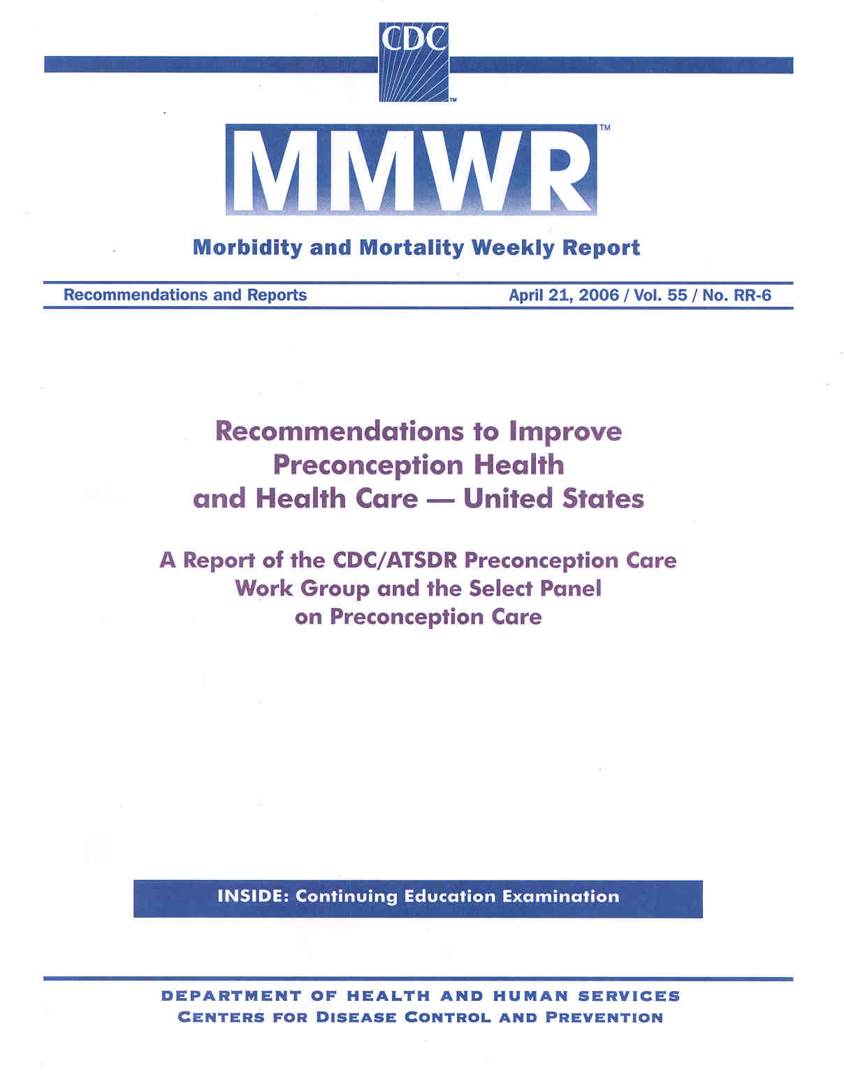
Next

Slide 9
Summary of CDC/Select Panel’s
Ten Recommendations to Improve
Preconception Health and Health Care
Consumer
Individual responsibility across the lifespan
Consumer awareness
Clinical
Preventive visits
Interventions for identified risks
Interconception care
Prepregnancy checkup
Financing
Health insurance coverage for women with low incomes
Public health Programs and Strategies Research
Surveillance of impact
Increase evidence base
Next

Slide 10

The focus of this module will be Recommendation 3:
“As a part of primary care visits, provide risk assessment and educational and health promotion counseling to all women of childbearing age to reduce reproductive risks and improve pregnancy outcomes.”
Next

Slide 11
What is Preconception Care?
In Module 1, preconception care was defined as:
Giving protection
Managing conditions
Avoiding exposures known to be teratogenic
… in order to achieve an optimal outcome of pregnancy for the woman, her child and her family.
Next

Slide 12

Giving Protection
Examples of giving protection:
  Folic acid supplementation to protect against neural tube defects and other congenital anomalies.
  Protection against infectious diseases
    Rubella
    Varicella
    Hepatitis B
    HIV/AIDS
Next

Slide 13

Managing Conditions
Examples of conditions known to be detrimental to reproductive outcomes if in poor control before conception:
  Diabetes
  Maternal PKU
  Obesity
  Hypothyroidism
  Sexually transmitted infections
Next

Slide 14

Avoiding Exposures
Exposures known to be teratogenic or otherwise harmful in early pregnancy:
  Alcohol
  Tobacco
  Illegal Drugs
  Medications:
    Many antiseizure medications
    Oral anticoagulants
    Accutane
  Environmental toxins
Next

Slide 15
Some of these topics are already covered in my routine well woman care so what’s the difference?
Comprehensive well woman care is, in fact, preconception care for women who may become pregnant;
All women of reproductive potential deserve well woman care that includes a focus on reproductive choices--including choices about whether to become pregnant and the health of any future pregnancies they may someday have;
Some women may need more than routine well woman care but no woman needs less.
Next

Slide 16

Do I Really Have Time to Add One More Emphasis to My Patient’s Visits?
If you take care of women of reproductive
potential . . .“It’s not a question of whether
you provide preconception care, rather it’s
a question of what kind of preconception
care you are providing.”
Joseph Stanford and Debra Hobbins
Stanford JB, Hobbins D. Preconception risk assessment In: Ratcliff SD, Baxley L, Byrd JE, Sakornbut EL, eds., Family practice obstetrics, 2nd ed. St. Louis, MO: Mosby, 2001:1-13.
Next

Slide 17



Wouldn’t it be more efficient to limit preconception health promotion information to women who are intending to become pregnant in the near future?
Next

Slide 18

No, because:
50% of pregnancies in the US are unintended.
Most preconception health promotion is appropriate to all women, irrespective of pregnancy plans.
Women are not likely to come for an additional encounter for preconception care
Next

Slide 19
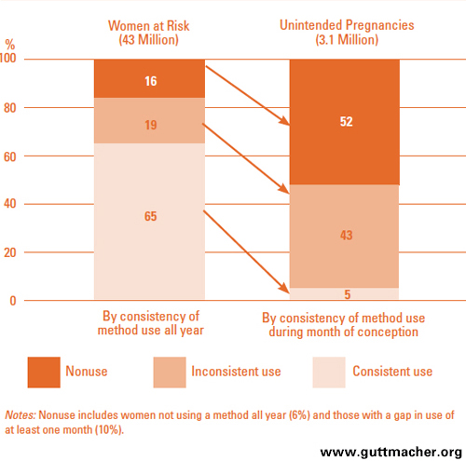
Women’s Contraceptive Use and Number of Unintended Pregnancies in the United States
Next

Slide 20
“Every Woman - Every Time” is Opportunistic Care
Takes advantage of all health care encounters to stress prevention opportunities throughout the lifespan
Recognizes that in almost all cases preconception wellness results in good health for women, irrespective of pregnancy intentions (see module 1)
Addresses conception and contraception choices at every encounter
Involves all medical specialties—not only those directly involved in reproductive health
Next

Slide 21
“Preconception care offers health
services that allow women to
maintain optimal health for
themselves, to choose the
number and spacing of their
pregnancies and, when desired,
to prepare for a healthy baby…
Next

Slide 22
“Thus, preconception care is not
something new that is being
added to the already
overburdened healthcare
provider, but it is a part of
routine primary care for women
of reproductive age. . .
Next

Slide 23
“. . .the provision of smoking
cessation services is preconception care;
choosing a medication for a patient with hypertension is preconception care. . .”
Next

Slide 24
In summary, much of preconception care merely involves the provider reframing his or her thinking, counseling and
decision-making to accommodate the possibility of a pregnancy before the next clinical encounter.
Atrash, et al. Where is the “W”oman in MCH? AJOG.
Click here to link to complete article
Next

Slide 25
For Every Woman of Childbearing Potential Every Time She Is Seen
Identify modifiable and non-modifiable risk factors for her own health status and the health of any pregnancies and offspring
Provide timely counseling about risks and strategies to reduce the potential impact of the risks on her and on any future pregnancies
Provide risk reduction strategies consistent with best practices.
Next

Slide 26

Opportunities to Incorporate
“Every Woman, Every Time”
Well woman visits
Annual exams
Family planning encounters
Chronic disease visits
Postpartum exams
Next

Slide 27

Areas of Overlap in Routine Care and Preconception Considerations
Nutritional status
Infectious diseases and immunization status
Substance use
Chronic disease profile
Medication use and needs
Reproductive history
Contraceptive needs and desires
Family/genetic history
Next

Slide 28

How Do I Know “Best Practices” for Preconception Health?
Next

Slide 29
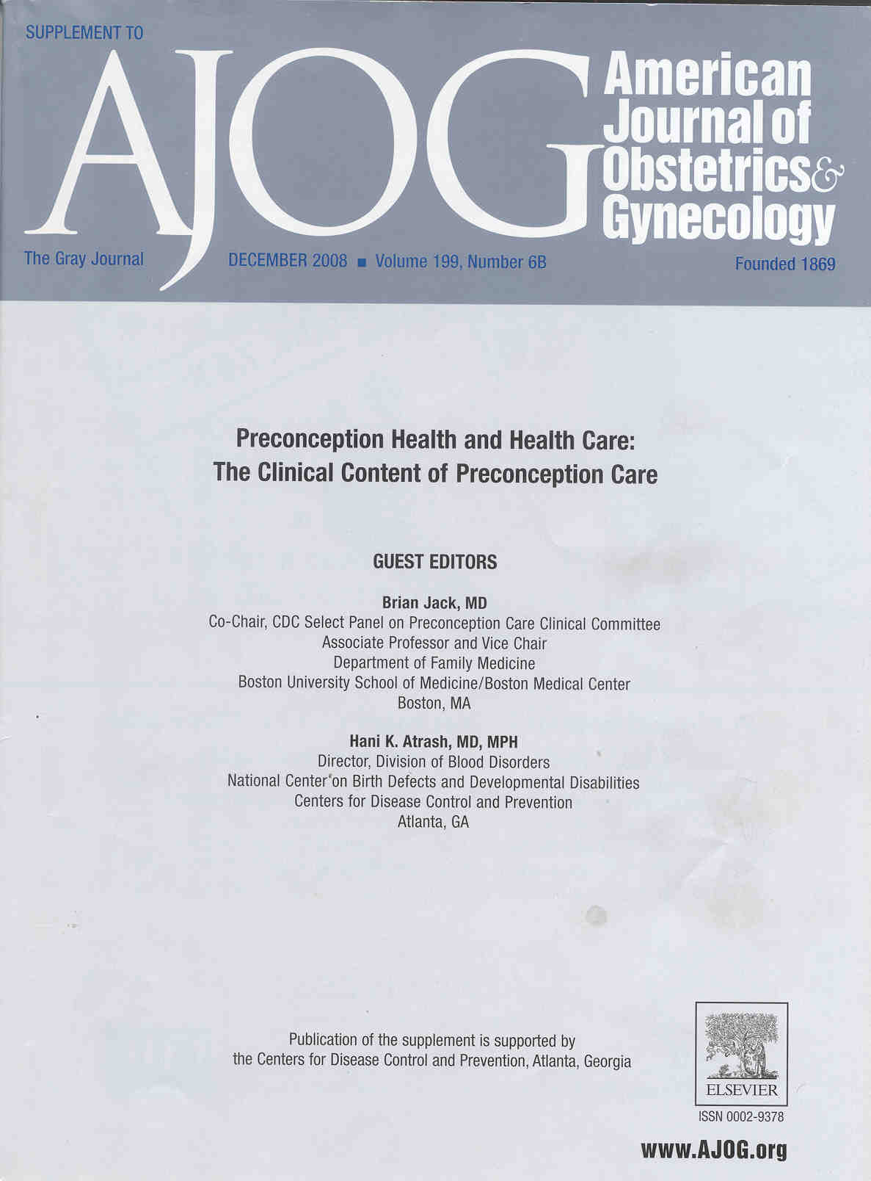
Source for Evidence Based Clinical Content for Preconception Care
American Journal of Obstetrics and Gynecology, Volume 199, Issue 6, Supplement 2, December 2008 (click above to link to all 17 articles)
Next

Slide 30
Recommendations on the Clinical Content of Preconception Care
(AJOG, 2008)
Family planning and reproductive life plan (click here)
Nutritional status, including weight status, nutrient intake, and vitamin use (click here)
Immunizations (click here)
Infectious diseases (click here)
Interpersonal Violence (click here)
Next

Slide 31
Family Planning and
Reproductive Life Plan
Routine health promotion activities for all women of reproductive age should begin with screening women for their intentions to become or not become pregnant in the short and long term and their risk of conceiving (whether intended or not).
Providers should encourage patients (women, men and couples) to consider a reproductive life plan and educate patients about how their plan impacts contraceptive and medical decision making.
Every woman of reproductive age should receive information and counseling about all forms of contraception and the use of emergency contraception that is consistent with their reproductive life plan and risk of pregnancy.
Strength of evidence: A Quality of evidence: III
Back

Slide 32
Weight Status
All women should have their body mass index (BMI) calculated at least annually.
All women with BMIs > 26kg/m² should be counseled about the risks to their own health, the risks for exceeding the overweight category, and the risks to future pregnancies, including infertility. These women should be offered specific behavioral strategies to decrease caloric intake and increase physical activity and be encouraged to consider enrolling in structured weight loss programs.
All women with a BMI < 19.8kg/m² should be counseled about the short- and long-term risks to their own health and the risks to future pregnancies, including infertility. All women with a low BMI should be assessed for eating disorders and distortions of body image. Women unwilling to consider and achieve weight gain may require referral for further evaluation of eating disorders.
Strength of evidence: A Quality of evidence: III
Next

Slide 33


Nutrient Intake
All women of reproductive age should be assessed for nutritional adequacy and receive a recommendation to take a multivitamin supplement if any question of ability to meet the recommended daily allowance through food sources is uncovered.
Care must be taken to counsel against ingesting supplements in excess of the recommended daily allowance.
Strength of evidence: A Quality of evidence: III
Nutrient | RDA for women of childbearing age
Folic acid | 400 ug daily
Vitamin D | 600 IU daily
Calcium | 1000 mg daily
Iron | 15 -18 mg daily
Iodine | 150 mg daily
Next

Slide 34
Folate and Folic Acid Intake
All women of reproductive age should be advised to
ingest 0.4mg(400µg) of synthetic folic acid daily from
fortified foods and/or supplements and to consume a
balanced, healthy diet of folate-rich food.
Women with a history of neural tube defects should be counseled to take a larger dose of folic acid, up to 4mg.
Strength of evidence: A Quality of evidence: I-a
Back

Slide 35

Immunizations
All women of reproductive age should be up to date on their immunizations, especially the Tdap (Tetanus-diphtheria-pertussis) and MMR (measles, mumps, and rubella) vaccines.
They should be screened annually for medical, lifestyle, and occupational risks for other infections and be offered indicated immunizations and counseling.
Strength of evidence: A
Quality of evidence: III
Back

Slide 36

Infectious Diseases
Click on the following links for more information on each disease
Human papillomavirus (HPV)
Human immunodeficiency virus
Hepatitis C
Tuberculosis
Toxoplasmosis
Cytomegalovirus
Listerosis
Parvovirus
Malaria
Gonorrhea
Chlamydia
Syphilis
Herpes simplex virus
Asymptomatic bacteruria
Periodontal disease
Bacterial vaginosis (BV)
Group B Streptococcus
Back

Slide 37
Human Papillomavirus (HPV):
Women should be screened routinely for HPV-associated abnormalities of the cervix with cytologic (Papanicolaou) screening.
Recommended subgroups should receive the HPV vaccine for the purpose of decreasing the incidence of cervical abnormalities and cancer.
By avoiding procedures of the cervix because of abnormalities caused by HPV, the vaccine could help maintain cervical competency during pregnancy.
Strength of evidence: B Quality of evidence: II-2
Back

Slide 38
Human immunodeficiency virus (HIV)
All men and women should be encouraged to know their HIV status before pregnancy and should be counseled about safe sexual practices.
Women who test positive must be informed of the risks of vertical transmission to the infant and the associated morbidity and mortality probabilities. These women should be offered contraception.
Women who choose pregnancy should be counseled about the availability of treatment to prevent vertical transmission, the risks of that treatment and that treatment may need to begin before pregnancy.
Strength of evidence: A Quality of evidence: I-b
Back

Slide 39
Hepatitis C
There are no data that preconception screening for hepatitis C in low-risk women will improve perinatal outcomes.
Screening for high-risk women is recommended.
Women who are positive for hepatitis C and desire pregnancy should be counseled regarding the uncertain infectivity, the link between viral load and neonatal transmission, the importance of avoiding hepatotoxic drugs, and the risk of chronic liver disease.
Women who are being treated for hepatitis C should have their reproductive plans reviewed and use adequate contraception while on therapy
Strength of evidence: C Quality of evidence: III
Back

Slide 40
Tuberculosis
All high-risk women should be screened for tuberculosis and treated appropriately before pregnancy.
Strength of evidence: B Quality of evidence: II-2
Back

Slide 41
Toxoplasmosis
There is no clear evidence that preconception counseling and testing will reduce Toxoplasma gondii infection or improve treatment of women who are infected. However, if preconception testing is done, women who test positive can be reassured that they are not at risk of contracting toxoplasmosis during pregnancy; women who are negative can be counseled about ways to prevent infection during pregnancy. For women who convert during pregnancy, treatment should be offered.
Strength of evidence: C Quality of evidence: III
Back

Slide 42
Cytomegalovirus
Women who have young children or who work with infants and young children should be counseled about reducing the risk of cytomegalovirus through universal precautions (eg, the use of latex gloves and rigorous hand-washing after handling diapers or after exposure to respiratory secretions.)
Strength of evidence: C Quality of evidence: II-2
Back

Slide 43
Listeriosis
Because it is not clear at what point in pregnancy women who exposed to Listeria will become ill, preconception care should include teaching women to avoid pâté and fresh soft cheeses made from unpasteurized milk and to cook ready-to-eat foods such as hotdogs, deli meats, and left-over foods prior to conception and during pregnancy.
Strength of evidence: C Quality of evidence: III
Back

Slide 44
Parvovirus
There is not yet evidence that screening for antibody status against parvovirus or counseling about ways to avoid infection in pregnancy will improve perinatal outcomes. Good hygiene practices should be encouraged for all pregnant women.
Strength of evidence: E Quality of evidence: III
Back

Slide 45
Malaria
Women who are planning a pregnancy should be advised to avoid travel to malaria-endemic areas.
If travel cannot be deferred, the traveler should be advised to defer pregnancy and use effective contraception until travel is completed and to follow preventive approaches.
Antimalarial chemoprophylaxis should be provided to women who plan a pregnancy who travel to malaria-endemic areas.
Strength of evidence: C Quality of evidence: III
Back

Slide 46
Gonorrhea
High-risk women should be screened for gonorrhea during a preconception visit, and women who are infected should be treated.
Screening should also occur early during pregnancy and be repeated in high-risk women.
Strength of evidence: B Quality of evidence: II-2
Back

Slide 47
Chlamydia
All sexually active women < 25 years and all women at increased risk for infection with Chlamydia (including women with a history of STI infections, new or multiple sexual partners, inconsistent condom use, sex work, and drug use) should be screened at routine encounters before pregnancy.
Strength of evidence: A Quality of evidence: II-a
Back

Slide 48
Syphilis
High-risk women should be screened for syphilis during a preconception visit, and women who are infected should be treated.
Additionally, the United States Preventive Services Task Force and Centers for Disease Control and Prevention recommends screening all women during pregnancy for syphilis.
Strength of evidence: A Quality of evidence: II-1
Back

Slide 49
Herpes simplex virus
During a preconception visit, women with a history of genital herpes should be counseled about the risk of vertical transmission to the fetus and newborn child; women with no history should be counseled about asymptomatic disease and acquisition of infection.
Although universal serologic screening is not recommended in the general population, type-specific serologic testing of asymptomatic partners of persons with genital herpes is recommended.
Strength of evidence: B Quality of evidence: II-1
Back

Slide 50
Asymptomatic bacteruria
There have been no studies to show that women with asymptomatic bacteruria who are identified and treated in the preconception period have lower rates of low birthweight infants.
Further, women often have persistent or recurrent bacteruria, despite repeated courses of antibiotics; such re-infection frequently occurs within a few months of treatment.
Thus, a woman who is identified and treated for asymptomatic bacteruria before conception must be screened again during pregnancy.
For these reasons, screening for this condition as part of routine preconception care is not recommended.
Strength of evidence: E Quality of evidence: II-1
Back

Slide 51
Periodontal Disease
There are no studies that evaluated the role of preconception or interconception screening and treatment of periodontal disease and its effect on reproductive outcomes.
Routine screening and treatment of periodontal disease during preconception care, although of considerable benefit to the mother, is not recommended at this time as part of preconception care, because there is no clearly shown benefit to the fetus.
Strength of evidence: C Quality of evidence: I-b
Back

Slide 52
Bacterial vaginosis (BV)
There are no studies that evaluate the role of preconception or interconception screening and treatment for BV and its effect on reproductive outcomes; such studies are a high priority.
Routine screening and treatment of BV among asymptomatic pregnant women of average risk should not be performed because of the lack of demonstrated benefit and the possibility of adverse effects of treatment for women without BV.
For pregnant women with pervious preterm delivery, the inconsistent results of well-done studies prevent a clear recommendation for or against screening; however, some studies support early screening and treatment with a regimen that contains oral metronidazole.
For women with symptomatic BV infection, treatment is appropriate for pregnant women and for women planning pregnancy.
Strength of evidence: D (women w/out history of preterm delivery)
C (women w/ history of preterm delivery)
Quality of evidence: I-b
Back

Slide 53
Group B Streptococcus
Screening for group B Streptococcus colonization at a preconception visit is not indicated and should not be performed.
Strength of evidence: E Quality of evidence: I-2
Back

Slide 54
Interpersonal Violence
Patients should be assessed for past or current experiences of physical, sexual, or emotional violence from any source.
If a woman is being abused, or has been abused in the recent past, the provider should offer appropriate evaluation, counseling and treatment for physical injuries, sexually transmitted infections, unintended pregnancy, and psychological trauma, including the provision of emergency contraception and empiric antimicrobial therapy in the case of sexual assault.
Providers should give brief counseling to: 1) promote the patient’s immediate safety; 2) discuss the possible relationship between current or previous interpersonal and domestic violence and the patient’s health concerns; and, 3) link the patient to support services and resources including community agencies that specialize in abuse for counseling, legal advice, and other services.
    (While not included in the 2008 AJOG review, the significance of IPV has warranted the Preconception Clinical Taskforce to include it in their Clinical Toolkit.)
Back

Slide 55
Recommendations on the Clinical Content of Preconception Care
(AJOG, 2008)
Substance use (click here)
Chronic disease profile (click here)
Medication use and needs (click here)
Reproductive history (click here)
Family/genetic history (click here)
Next

Slide 56
Substance use
All women should be assessed for use of tobacco at each encounter with the healthcare system; women who smoke should be counseled to limit exposure.
All women should be assessed at least annually for alcohol use patterns and risky drinking behavior and be provided with appropriate counseling; all women should be advised of the risks to the embryo/fetus of alcohol exposure in pregnancy and that no safe level of consumption has been established.
Strength of evidence: A
Quality of evidence: II-2 (tobacco)
Quality of evidence: III (alcohol)
Back

Slide 57
Chronic Disease
For women with chronic medical conditions, preconception care should include an assessment of the likelihood of pregnancy affecting the mother’s health and of the medical condition affecting the pregnancy.
For women with certain conditions, preconception care might include advice modifying the treatment of the condition, as well as the avoidance or timing of a potential conception.
When appropriate, patient should be referred for counseling to a provider with expertise in the management of their condition during pregnancy.
See Module #3: Maximizing Prevention: Targeted Preconception Care for Those with High Risk Conditions
Back

Slide 58

Medication Use
A review of all medications (prescribed and over-the-counter) used by a patient should be performed at all encounters with a health provider.
Efforts should be made to ensure that the woman is on the simplest effective regimen to optimize her health.
As part of preconception care, if the woman is using a teratogenic medication, if possible, these medications should be switched to other agents. For those in whom they are indicated, careful counseling should be done indicating the risks, alternatives and a plan for contraception initiated.
In general, patients on medications should be counseled as to what to do with their medication regimen should they conceive. When appropriate, patients should be referred for counseling to a provider with expertise in the management of their condition during pregnancy.
Back

Slide 59

Reproductive History/ Previous Pregnancy Outcomes
Click on the following bullets for more information on each history type
Prior preterm birth
Prior cesarean delivery
Prior miscarriage
Prior stillbirth
Uterine anomalies
Back

Slide 60
Prior Preterm Birth
Pregnancy history should be obtained from all women of reproductive age. Women with a history of preterm or low-birthweight infant should be evaluated for remediable causes to be addressed before the next pregnancy and should be informed of the potential benefit of treatment with progesterone in subsequent pregnancy.
Strength of evidence: A Quality of evidence: I-a
Back

Slide 61
Prior Cesarean Delivery
Preconception counseling of women with previous cesarean delivery should include counseling about waiting at least 18 months before the next pregnancy to reduce risks of pregnancy complications and about possible modes of delivery so the patient enters the next pregnancy informed of the risks and options. Ideally, the counseling should begin immediately after the cesarean delivery and continue at postpartum visits.
Strength of evidence: A Quality of evidence: II-2
Back

Slide 62
Prior Miscarriage
Women with sporadic spontaneous abortion should be reassured of a low likelihood of recurrence and offered routine preconception care.
Women with > 3 consecutive early losses should be offered a work-up to identify a cause. Therapy that is based on the identified cause may be undertaken. For women with no identified cause, the prognosis is favorable with supportive care.
Strength of evidence: A Quality of evidence: I-a
Back

Slide 63
Prior Stillbirth
At the time of the stillbirth, a thorough investigation to determine the cause should be performed and communicated to the patient.
At the preconception visit, women with a previous stillbirth should receive counseling about the increased risk of adverse pregnancy outcomes and may require referral for support. Any appropriate work-up to define the cause of the previous stillbirth should be preformed if it was not done as part of the initial work-up.
Risk factors that can be modified before the next pregnancy should be addressed (e.g., smoking cessation).
Strength of evidence: B Quality of evidence: II-2
Back

Slide 64
Uterine Anomalies
A uterine septum in a woman with poor previous reproductive performance should be corrected hysteroscopically before the next conception. All other anomalies call for specific delineation of the anomaly and any associated vaginal and renal malformations. Although surgical correction may be advised in some cases, heightened awareness and surveillance during a subsequent pregnancy and labor should help optimize outcomes.
Strength of evidence: B Quality of evidence: II-3
Back

Slide 65
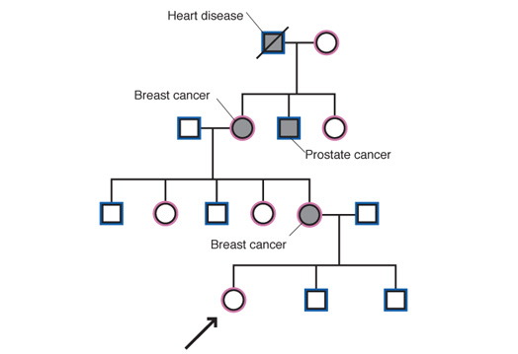
Family & Genetic History
Click on the following bullets for more information on each history type
All individuals
Ethnicity-based
Family history
Previous pregnancies
Known genetic conditions
Back

Slide 66

All individuals
All women who are considering pregnancy should have a screening history in the preconception visit.
Providers should ask about risks to pregnancy on the basis of maternal age, maternal and paternal medical conditions, obstetric history, and family history. Ideally, a 3-generation family medical history should be obtained for both members of the couple, with the goal of identifying known genetic disorders, congenital malformations, developmental delay/mental retardation, and ethnicity.
If this screening history indicates the possibility of a genetic disease, specific counseling should be given, which may include referral to a genetic counselor or clinical geneticist. The ideal timing for genetic investigation and counseling is before a couple attempts to conceive.
Strength of evidence: B Quality of evidence: III
Back

Slide 67
Ethnicity-based Screening
Couples who are at risk for any ethnicity-based conditions should be offered preconception counseling about the risks of that condition to future pregnancies. Screening and/or testing should be offered on the basis of the couples’ preferences. This may require referral to a genetic counselor or clinical geneticist, especially in the instance of a positive finding.
All couples, regardless of ethnicity, should be made aware of cystic fibrosis carrier screening.
Most common screening tests based on ethnic background:
Strength of evidence: B Quality of evidence: II-3
Non-Hispanic White: | Cystic Fibrosis carrier screening
Eastern European Jewish descent (Ashkanazi Jews): | Screening for Tay-Sachs disease, Canavan disease, familial dysautonomia and cystic fibrosis
African, Mediterranean and Southeast Asian: | Screening for thalassemias and sickle cell disease
Back

Slide 68
Family History
Individuals identified as having a positive family screening should be offered a referral to an appropriate specialist to better quantify the risk to a potential pregnancy.
Strength of evidence: B Quality of evidence: II-3
Positive findings when screening for Family and Genetic History risks would include: (From womenshealth.gov)
A family history of a genetic condition, birth defect, or chromosomal disorder
Two or more spontaneous abortions, a stillbirth or an infant death from a cause that could relate to genetic risks
A child with a known inherited disorder, birth defect or intellectual disability
Back

Slide 69
Previous Pregnancies
If at least 1 member of a couple has conceived a pregnancy with a known genetic or chromosomal disorder referral to an appropriate specialist should be considered to better quantify the risk of recurrence in a subsequent pregnancy.
For a couple with this history, in vitro fertilization with preimplantation genetic diagnosis may be an option.
Strength of evidence: C Quality of evidence: III
Back

Slide 70
Known Genetic Conditions
Suspected genetic disorders may require further work-up prior to conception. Known or discovered genetic conditions should be optimally managed before and after conception.
Strength of evidence: B Quality of evidence: II-3
Back

Slide 71

Case Study 1: Lisa
Lisa is a 24 year old presenting for her annual exam and contraceptive care.
When reviewing her history and pre-exam assessments, you uncover the following:
Next

Slide 72
Reproductive History
  G0P0
  Routinely having sexual intercourse
  Monogamous relationship x 3 years
  Using vaginal ring x 2 years without problems
  Last 3 pap smears normal (click here for current pap smear recommendations)
  Reproductive life plan (click here for an example; click here for Lisa’s current plan)
Next

Slide 73

Model of a
Reproductive Life Plan
Do you hope to have any (more) children?
How many children do you hope to have?
How long do you plan to wait until you (next) become pregnant?
What family planning method do you intend to use until you are ready to become pregnant?
How sure are you that you will be able to use this method without any problems?
What can I do today to help you achieve your plan?
Back
From: CDC Reproductive Life Plan at
http://www.cdc.gov/preconception/reproductiveplan.html

Slide 74
Lisa’s
Reproductive Life Plan
Do you hope to have any children?
How many children do you hope to have?
How long do you plan to wait until you become pregnant?
What family planning method do you intend to use until you are ready to become pregnant? How sure are you that you will be able to use this method without any problems?
What can I do today to help you achieve your plan?
  Yes
  Three
  Six to twelve months
  Continue to use the ring
  Fairly sure, have used in the past without a problem
  I just need a new
  prescription today
Back

Slide 75
Pap Smear Recommendations
Cervical cytology screening should begin at age 21 years (younger women should not be screened regardless of age of sexual initiation or behavior-related risk factors.
Women ages 21-29 years should be screened very 3 years with cervical cytology alone.
Women aged 30 to 65 ideally should be screened every 5 years by co-testing with cytology and HPV testing; screening with cytology alone every 3 years is acceptable.
ACOG Practice Bulletin 131: Screening for cervical cancer. Obstet Gynecol 2012 Nov;120(5):1222-38.
Back

Slide 76

Medical history and
Medication Use
Crohn’s disease diagnosed 6 years ago; currently under control, Sees GI specialist every 6 months.
Azathioprine – Category D
Tylenol, 2 tabs prn headache (approximately once per month)
No vitamins or supplements
No herbals
Next

Slide 77

Family History and Genetic Risks
  Two male cousins mild mental retardation
  No other known other positive family history
Next

Slide 78

Substance Exposures
Tobacco, alcohol, non-therapeutic drugs:
2-3 glasses of beer per occasion,
2-3 times a month,
no other exposures.
Next

Slide 79

Nutritional Status and Exercise Habits
Ht 64”; Wt 141 (click here for BMI chart)
Minimal calcium intake
Swims laps x 30 minutes 2x/month
No weight bearing exercise
Next

Slide 80
Back
Source: Adapted from Clinical Guidelines on the Identification, Evaluation, and Treatment of Overweight and Obesity in Adults: The Evidence Report

Slide 81
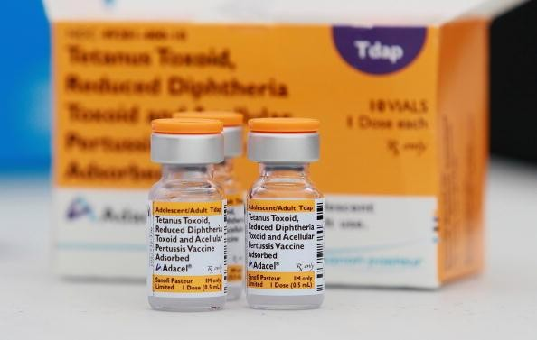
Immunization Status
Immunizations up-to-date except:
    No Tdap > 10 years
Next

Slide 82
What Are Specific Issues that Lisa’s Profile Suggests Need Attention?
Routine Health Promotion Issues?
  Click here for a list of routine health promotion issues that are important for Lisa, whether she ever becomes pregnant or not
Specific Preconception Issues?
  Click here for a list of preconception topics that are important for Lisa
Next

Slide 83
Routine Well Woman Care Considerations for Lisa
Needs reliable contraceptive method for at least next 6 months (click here for clinical recommendation)
Poor calcium intake (click here for clinical recommendation)
Not taking any supplements (click here for clinical recommendation)
Minimal exercise and none that is weight bearing
(click here for clinical recommendation)
Tdap > 10 years old (click here for clinical recommendation)
Alcohol use exceeds recommendations for daily consumption (click here for clinical recommendation)
Back

Slide 84
Specific Preconception Care Considerations for Lisa
Hopes to become pregnant in next year
Chronic disease (Crohn’s disease) (click here for clinical recommendation)
Taking prescription medications (click here for clinical recommendation)
FH mental retardation (two male nephews) (click here for clinical recommendation)
2-3 drinks of alcohol per occasion (click here for clinical recommendation)
Tdap protection out of date (click here for clinical recommendation)
Not using multivitamins or folic acid (click here for clinical recommendation)
Back

Slide 85
Overlap of Well-Woman and Preconception Care Needs:
Family planning/contraceptive needs
2-3 drinks of alcohol per occasion
Tdap protection out of date
Not taking multivitamins or folic acid
Next

Slide 86

Family Planning
Every woman of reproductive age should receive information and counseling about all forms of contraception and the use of emergency contraception that is consistent with the reproductive life plan and risk of pregnancy.
Strength of evidence: A
Quality of evidence: III
Back

Slide 87
Chronic Disease
For women with chronic medical conditions, preconception care should include an assessment of the likelihood of pregnancy affecting the mother’s health and of the medical condition affecting the pregnancy.
For women with certain conditions, preconception care might include advice modifying the treatment of the condition, as well as the avoidance or timing of a potential conception.
When appropriate, patient should be referred for counseling to a provider with expertise in the management of their condition during pregnancy.
See Module #3: Maximizing Prevention: Targeted Preconception Care for Those with High Risk Conditions
Back

Slide 88
Nutrient Intake
All women of reproductive age should be assessed for nutritional adequacy and receive a recommendation to take a multivitamin supplement if any question of ability to meet the recommended daily allowance through food sources is uncovered.
Care must be taken to counsel against ingesting supplements in excess of the recommended daily allowance.
Strength of evidence: A Quality of evidence: III
Nutrient | RDA for women of childbearing age
Folic acid | 400 ug daily
Vitamin D | 600 IU daily
Calcium | 1000 mg daily
Iron | 15 -18 mg daily
Iodine | 150 mg daily
Next

Slide 89
Folate and Folic Acid Intake
All women of reproductive age should be advised to
ingest 0.4mg(400µg) of synthetic folic acid daily from
fortified foods and/or supplements and to consume a
balanced, healthy diet of folate-rich food.
Women with a history of neural tube defects should be counseled to take a larger dose of folic acid, up to 4mg.
Strength of evidence: A Quality of evidence: I-a
Back

Slide 90

Physical Activity
All women should be assessed regarding weight-bearing and cardiovascular exercise and be offered recommendations appropriate to their physical abilities.
Strength of evidence: C Quality of evidence: II-2
Back

Slide 91


Calcium
Women of reproductive age should be counseled about
the importance of achieving the recommended calcium intake level through diet or supplementation.
Calcium supplements should be recommended if dietary sources are inadequate.
Strength of evidence: A Quality of evidence: I-b
Back

Slide 92
Tetanus- Diphtheria- Pertussis (Tdap) vaccination
Women of reproductive age should be up-to-date for tetanus toxoid, because passive immunity is probably protective against neonatal tetanus.
The tetanus-diphtheria-pertussis vaccine is recommended for women who might become pregnant or immediately after delivery to avoid complications of pertussis in the newborn infant.
Strength of evidence: B Quality of evidence: III
Pertussis outbreaks have become more frequent in recent years, increasing the odds of infection for both women and their babies.
Back

Slide 93

Alcohol
All women of childbearing age should be screened for alcohol use.
Brief interventions should be provided in primary care settings, which include advice regarding the potential for adverse health outcomes (for the woman and for any pregnancies she may conceive).
Strength of evidence: B Quality I-a
Back

Slide 94

Prescription Medications
Azathioprine is categorized by the FDA as a Category D drug (click here for definitions of categories)
Category D drugs are associated with risk to the fetus but potential benefits may outweigh risks.
Women should discuss their desires to become pregnant with the prescribing clinician and explore options to minimize exposure to potentially harmful medications while maximizing their own health status
Women should be specifically advised to never stop a medication without consultation with the prescribing clinician
Back

Slide 95
FDA Drug Categories
A - Controlled studies show no risk
B - No evidence of risk in humans
C - Risk cannot be ruled out
D - Positive evidence of risk exists
X - Contraindicated in pregnancy
Back

Slide 96
Family History of
Mental Retardation
Individuals identified as having a family history of developmental delay, congenital anomalies, or other genetic disorders should be offered a referral to an appropriate specialist to better quantify the risk to a potential pregnancy.
Strength of evidence: B Quality of evidence: II-3
Back

Slide 97

Case Study 2: Jasmine
Jasmine is a 29 year old presenting for her postpartum exam.
Next

Slide 98
Reproductive history
G2P1011
First pregnancy ended 2 years ago with SAB at 9 wks GA;
Last pregnancy ended 7 weeks ago with a spontaneous vaginal delivery at 38 wks GA of a 3890 gm male infant;
Last pregnancy complicated by GDM which was controlled with insulin.
Exclusively breastfeeding and plans to pump when returns to work.
Next

Slide 99
Jasmine’s
Reproductive Life Plan
Do you hope to have any children?
How many children do you hope to have?
How long do you plan to wait until you become pregnant?
What family planning method do you intend to use until you are ready to become pregnant?
How sure are you that you will be able to use this method without any problems?
What can I do today to help you achieve your plan?
  Yes
  Four
  Six months
  Condoms
  Mostly sure
  Nothing I can think of
Next

Slide 100
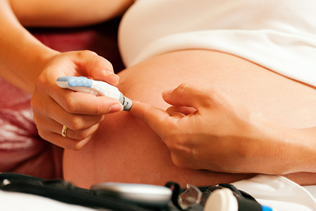
Medical History and
Medication Use
GDM
  No prescription medicines
  No over-the-counter medicines
  No vitamins or supplements
  No herbals
Next

Slide 101
Family History and
Genetic Conditions
Negative except husband’s niece just diagnosed with cystic fibrosis
In reviewing Jasmine’s prenatal profile you note that she has already had genetic screening for cystic fibrosis and was found not to be a carrier.
For the routine recommendation regarding preconception screening for ethnicity-based genetic risk factors, click here
To learn more about the preconception considerations around cystic fibrosis, please review the guidance provided under the “Key Articles and Guidance” tab of this website.
Next

Slide 102
Ethnicity-based Screening
Couples who are at risk for any ethnicity-based conditions should be offered preconception counseling about the risks of that condition to future pregnancies. Screening and/or testing should be offered on the basis of the couples’ preferences. This may require referral to a genetic counselor or clinical geneticist, especially in the instance of a positive finding.
Most common screening tests based on ethnic background:
Strength of evidence: B Quality of evidence: II-3
Non-Hispanic White: | Cystic Fibrosis carrier screening
Eastern European Jewish descent (Ashkanazi Jews): | Screening for Tay-Sachs disease, Canavan disease, familial dysautonomia and cystic fibrosis
African, Mediterranean and Southeast Asian: | Screening for thalassemias and sickle cell disease
Back

Slide 103
Substance Use, Nutritional Status and Exercise Habits
No exposure to alcohol, tobacco or illicit substances
Ht 62” Wt 160 (pregravid weight 148; gestational weight gain 37 pounds)
  BMI Chart found here
Calcium intake 4-6 glasses whole milk/day
No routine exercise; prior to pregnancy walked with husband 1x/wk
Next

Slide 104
Back
Source: Adapted from Clinical Guidelines on the Identification, Evaluation, and Treatment of Overweight and Obesity in Adults: The Evidence Report

Slide 105

Immunization and Infectious Disease Status:
Up-to-date except:
  Was noted to have a negative rubella titer in prenatal care; did not receive rubella vaccine before discharge from hospital.
Next

Slide 106
What Are Specific Issues that Jasmine’s Profile Suggests Need Attention?
Routine Health Promotion Issues?
  Click here for a list of routine health promotion issues that are important for Jasmine, whether she ever becomes pregnant or not
Specific Preconception Issues?
  Click here for a list of interconception topics that are important for Jasmine
Next

Slide 107
Overlap of Jasmine’s Well Woman and Interconception Care Needs
Interconception Care Needs
Well Woman Care Needs
Contraceptive needs(click here for clinical recommendation)
History of GDM (click here for information about risks and follow-up)
No evidence rubella immunity (click here for clinical recommendation)
Overweight (BMI 29) (click here for clinical recommendation)
Not taking any supplements (click here for clinical recommendations)
Well woman specific: No routine exercise, either weight-bearing or cardio (click here for clinical recommendation)
Desires pregnancy in next 6 months (click here for information on short interconceptional period)
History of GDM (click here for information on follow-up of GDM)
No evidence rubella immunity (click here for clinical recommendation)
Overweight (BMI 29) (click here for clinical recommendation)
Not taking any supplements(click here for clinical recommendation)
Interconception specific: Family History of cystic fibrosis (click here for clinical recommendation)
Back

Slide 108
Overlap of Well-Woman and Preconception Care Needs:
History of GDM (increases risks of Type 2 diabetes)
Family planning/contraceptive needs (especially needs counseling regarding risks of short interconceptional spacing)
No rubella immunity
Overweight (may increase risks of GDM and development of Type 2 diabetes)
No physical exercise (may increase risks of GDM and development of Type 2 diabetes)
Not taking multivitamins or folic acid
Next

Slide 109
Ethnicity-based Screening
Couples who are at risk for any ethnicity-based conditions should be offered preconception counseling about the risks of that condition to future pregnancies. Screening and/or testing should be offered on the basis of the couples’ preferences. This may require referral to a genetic counselor or clinical geneticist, especially in the instance of a positive finding.
All couples, regardless of ethnicity, should be made aware of cystic fibrosis carrier screening.
Most common screening tests based on ethnic background:
Strength of evidence: B Quality of evidence: II-3
Non-Hispanic White: | Cystic Fibrosis carrier screening
Eastern European Jewish descent (Ashkanazi Jews): | Screening for Tay-Sachs disease, Canavan disease, familial dysautonomia and cystic fibrosis
African, Mediterranean and Southeast Asian: | Screening for thalassemias and sickle cell disease
Back

Slide 110
Short Interconceptional Periods
Both short and long interpregnancy intervals have been associated with in increased risk of adverse perinatal outcomes.
The reasons for the associations are unclear.
A meta-analysis found interpregnancy intervals shorter than 18 mo and longer than 59 mo are significantly associated with adverse perinatal outcomes.
    Conde-Agudelo, et al JAMA 2006; 295 (15), 1809-1823
Back

Slide 111
History of GDM
Meta-analysis indicates that women with GDM have a RR of developing type 2 diabetes of 7.43 (95% CI 4.49-11.51) when compared with women who had a normoglycemic pregnancy (Bellamy, et al. Lancet 2009;373: 1773-79)
Screening for type 2 diabetes is a recommended component of postpartum care (ADA, ACOG)
Postpartum attention to lifestyle modifications, such as healthy diet, physical activity and breast-feeding, might reduce or potentially prevent women who experienced GDM from progressing to type 2 diabetes. (Bentley-Lewis, et al. Nature Clinical Practice 2008; 4(10) 552-558)
Back

Slide 112

Overweight
All women should have their BMI calculated at least annually.
All women with a BMI of > 25kg/m² should be counseled about the risks to their own health, the additional risks associated with exceeding the overweight category, and the risks to future pregnancies, including infertility.
All women with a BMI of > 25kg/m² should be offered specific strategies to improve the balance and quality of the diet, to decrease caloric intake, and to increase physical activity and should be encouraged to consider enrolling in structured weight loss programs.
Strength of evidence: A Quality of evidence: III
Back

Slide 113
Nutrient Intake
All women of reproductive age should be assessed for nutritional adequacy and receive a recommendation to take a multivitamin supplement if any question of ability to meet the recommended daily allowance through food sources is uncovered.
Care must be taken to counsel against ingesting supplements in excess of the recommended daily allowance.
Strength of evidence: A Quality of evidence: III
Nutrient | RDA for women of childbearing age
Folic acid | 400 ug daily
Vitamin D | 600 IU daily
Calcium | 1000 mg daily
Iron | 15 -18 mg daily
Iodine | 150 mg daily
Next

Slide 114
Folate and Folic Acid Intake
All women of reproductive age should be advised to
ingest 0.4mg(400µg) of synthetic folic acid daily from
fortified foods and/or supplements and to consume a
balanced, healthy diet of folate-rich food.
Women with a history of neural tube defects should be counseled to take a larger dose of folic acid, up to 4mg.
Strength of evidence: A Quality of evidence: I-a
Back

Slide 115

Physical Activity
All women should be assessed regarding weight-bearing and cardiovascular exercise and be offered recommendations appropriate to their physical abilities.
Strength of evidence: C Quality of evidence: II-2
Back

Slide 116
Measles, Mumps, and
Rubella Immunity
All women of reproductive age should be screened for rubella immunity. MMR vaccination, which will provide protection against measles, mumps and rubella, should be offered to those who have not been vaccinated or who are non-immune and who are not pregnant. Because it is a live vaccine, women should be counseled not to become pregnant for 3 months after receiving the MMR vaccination.
Strength of evidence: A Quality of evidence: II-3
Back

Slide 117
Alcohol
All women of childbearing age should be screened for alcohol use and brief interventions should be provided in primary care settings which should include advice regarding the potential for adverse health outcomes (for the woman and for any pregnancies she may conceive).
Strength of evidence: B
Quality: I-a
Back

Slide 118
Family Planning
Every woman of reproductive age should receive information and counseling about all forms of contraception and the use of emergency contraception that is consistent with the reproductive life plan and risk of pregnancy.
Strength of evidence: A
Quality of evidence: III
Back

Slide 119
Congratulations,
You Are Now Done with Module 2!
Now that you have finished Module 2 of the curriculum you have these options:
  Take the post test and register for the appropriate CMEs
  Move on to any of the other modules: we recommend they be taken in order but this is not essential.
  Explore the rest of this website for the other offerings to help you incorporate evidence-based preconception care into your practice.
  Incorporate the recommendations of this module into your clinical practice.
  Check out the National Preconception Care Clinical Toolkit online here (link to be updated when website is launched)

